Slide 1

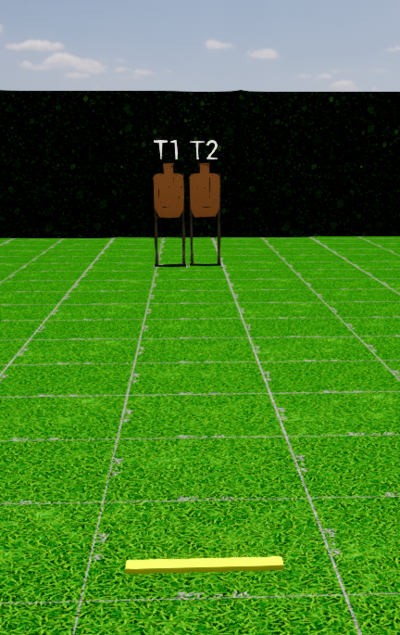
 | Interlake Sporting Association SUR, A Stage: .357 Sig Did It Course Designer: Marcel Englmaier
START POSITION: Toes touching fault line. Handgun: Loaded and holstered, wrists below belt. PCC: Stock on belt, muzzle pointed downrange. |  | STRINGS: 2 SCORING: Limited ROUND COUNT: 2 START-STOP: Audible - Last shot
STAGE PROCEDURE: String 1: At the start signal, engage T1 with 1 shot only to the head. String 2: At the start signal, engage T2 with 1 shot only to the head. Par time 4 seconds for each string.
Start

